Slide 1

EMR Well Architected

Slide 2
Well Architected EMR: Design for Production
Cost Efficiency
Performance
Reliability
Security
Notes:
Operational Excellence
Security
Reliability
Performance Efficiency
Cost Optimization

Slide 3
Well Architected EMR: Performance Efficiency
Choice of Instance Type and cluster size
Choice of Storage
Framework Performance

Slide 4
Performance: Choice of instance type - Master
Less than 50 nodes?
Heavy network
I/O
M4.xlarge or larger
NO
NO
YES
YES
M4.xlarge
C4 family or R4 with Enhanced networking
Notes:
Sometimes when there are 100s of nodes in the cluster, Master can get hammered with network i/o. So better to pick a larger instance type with enhanced networking/higher throughput.
Overall – smaller cluster with larger nodes would be better than larger cluster of smaller nodes.

Slide 5
Why EMR? – Compute Flexibility
General
Compute
Memory
Storage
M5 Family
M4 Family
C5 Family
C4 Family
X1 Family
R4 Family
D2 Family
I3 Family
Batch Process
Machine Learning
Interactive Analysis
Large HDFS
Notes:
3:36
The amount of data you can process depends on the capacity of your core nodes and the size of your data as input, during processing, and as output. The input, intermediate, and output data sets all reside on the cluster during processing.
Ref - http://docs.aws.amazon.com/ElasticMapReduce/latest/ManagementGuide/emr-plan-instances.html

Slide 6
How Many Nodes Do I Need?

Slide 7

Performance: Sizing
Transient use cases: ETL and batch analytics
Size cluster to complete within ten minutes of an hour boundary to optimize $$
Use Spot when you have flexible SLA to save $$
Use On Demand or Reserved to meet SLA at predictable cost
Always On use case: Interactive analytics
Size Core based on HDFS needs (statistics, logging, etc)
Reserve Master and Core nodes
Resize # of Task nodes as demand changes
Use Spot on Task nodes to save $$
Keep a ratio of Core to Task of 1:5 to avoid bottlenecks
Consider bidding Spot above the On Demand price to ensure greater stability
Notes:
Even with all data on S3 some HDFS is needed for statistics, logging, etc.
If there are too many task nodes for the core nodes, the tasks may not be able to connect to the cores causing failures (denial of service)

Slide 8
Performance: Sizing
How many tasks will you have to execute?
Based on data size, number of files/splits
Based on the job you are evaluating
When do you need to get done?
How much parallelism do you need?
How many tasks can each node process in parallel?
How much data do you need to store locally?
Which files are reused 3x or more?

Slide 9
Performance: Cluster Sizing
Guidelines:
Size based on HDFS storage first if needed
Add enough (task) nodes to handle processing
Do not add more than 5 tasks nodes per core node
Prefer smaller clusters of larger machines
It’s a space-time trade off

Slide 10
Performance: Choice of storage
EMRFS (S3)
HDFS
Ability to decouple
Reliable and durable
Cost efficient
Works well for jobs that read a dataset once per run
Need a persistent cluster
Reliability is configurable. But need multiple nodes to achieve replication factor
Great for jobs with iterative reads on the same dataset like machine learning
Combine with s3-dist-cp and move from S3 once to HDFS for iterative workloads
Notes:
-- HDFS for datasets that is read by an application for more than 3 passes within the same run

Slide 11
Storage Performance: S3 vs HDFS at Netflix
Notes:
http://techblog.netflix.com/2014/10/using-presto-in-our-big-data-platform.html

Slide 12
S3 Performance: Range GET vs Data Locality?
GET Range 0-64MB
GET Range 64-128MB
S3 object (use larger files)
EMR worker nodes
GET Range 128-192MB
GET Range (n-64)-nMB
Notes:
When an object is located in S3, Hadoop will use range gets to split the object in to chunks for processing. This is similar to HDFS blocks being used as input splits in the traditional implementations. When using S3, data locality doesn’t matter. Every node will start downloading a particular range given the object is larger than the configured S3 range size. This is configurable and by default it’s 64MB.
-- 2x faster on HDFS with to perfect data locality conditions. But it’s not practical at scale.

Slide 13
S3 Performance: Request Rate
Scales to high request rates
3,500 PUT/POST/DELETE per second per prefix in a bucket
5,500 GET per second per prefix in a bucket
No limits to the number of prefixes
10 Prefixes = 55,000 read requests per second
Notes:
Amazon S3 maintains an index of object key names in each AWS region. Object keys are stored in UTF-8 binary ordering across multiple partitions in the index. The key name dictates which partition the key is stored in. Using a sequential prefix, such as timestamp or an alphabetical sequence, increases the likelihood that Amazon S3 will target a specific partition for a large number of your keys, overwhelming the I/O capacity of the partition. If you introduce some randomnes
If you anticipate that your workload will consistently exceed 100 requests per second, you should avoid sequential key names. If you must use sequential numbers or date and time patterns in key names, add a random prefix to the key name. The randomness of the prefix more evenly distributes key names across multiple index partitions. Examples of introducing randomness are provided later in this topic.s in your key name prefixes, the key names, and therefore the I/O load, will be distributed across more than one partition.

Slide 14
File Formats - Considerations
Row vs Column
Write Performance
Read Performance
Schema Evolution
Block Compression
Notes:
The considerations for file format are whether you choose a row or a column format as this has an impact on write and read performance.
You also need to consider whether you need schema evolution and how important block compression is.
Let’s look at these in more detail.

Slide 15
Row vs Column Formats
ID | Age | State
123 | 20 | CA
345 | 25 | WA
678 | 40 | FL
999 | 21 | WA
ROW FORMAT
123 | 20 | CA
345 | 25 | WA
678 | 40 | FL
999 | 21 | WA
COLUMN FORMAT
123 | 345 | 678
999 | 20 | 25
40 | 21 | CA
WA | FL | WA
Notes:
Row based formats store the data in rows in the file.
This is the fastest way to write the data to disk but not necessarily the fastest read option as you have to skip over irrelevant data.
Column based formats store all the column values together in the file.
This leads to better compression as the same data types are now grouped together.
It also typically provides better read performance as you can skip columns that you are not interested in.

Slide 16
Schema Evolution – Add field
SCHEMA 1.0
WRITE
DATA 1.0
READ
SCHEMA 1.0
SCHEMA 2.0
DATA 2.0
READ
SCHEMA 2.0
WRITE
Notes:
Schema evolution refers to how well a format copes with a change such as an additional field.
Let’s say for example that we create a schema (1.0) and write some data with it (data 1.0).
Now, schema 1.0 can read that data with no problem because it’s the same as the schema that wrote it.
Now we add a field to the schema and call it 2.0.
Data that we write with this schema is Data 2.0 and this can be easily read with the new updated schema.

Slide 17
Schema Evolution – Add field
Reader ignores new field
SCHEMA 1.0
WRITE
DATA 1.0
SCHEMA 1.0
READ
READ
SCHEMA 2.0
DATA 2.0
SCHEMA 2.0
WRITE
Reader uses default value
Notes:
The interesting thing now though is can we read the new data with the old schema?
Yes we can, because the new schema will just ignore the new field.
What about reading the old data set with the new schema?
This we can also do if we’ve provided a default value in the new schema, because if we encounter a missing field we just use the default value.

Slide 18
File Formats
Feature | Text | Avro | ORC | Parquet
Service Support
- Amazon EMR | ✓ | ✓ | ✓ | ✓
- Amazon Redshift | ✓ | ✓ | ✓ (through Spectrum) | ✓ (through Spectrum)
Block Compression | X | ✓ | ✓ | ✓
Schema Evolution | X | ✓ | ✓ | ✓
Data Storage | Row | Row | Column | Column
Write Performance | Fast | Medium | Slow | Slow
Read Performance | Slow | Medium | Fast | Fast
Notes:
Here’s a comparison of some of the file formats and their attributes.
Only ORC and Parquet have the necessary features
Predicate pushdown where a condition is checked against the metadata to see if the rows need to be read.
Column projection to only read the bytes for the necessary columns.
ORC can use predicate pushdown based on either:
min and max for each column
optional bloom filter for looking for particular values
Parquet only has min/max. ORC can filter at the file level, stripe level, or 10k row level. Parquet can only filter at the file level or stripe level.
The previous answer mentions some of Avro's properties that are shared by ORC and Parquet:
They are both language neutral with C++, Java, and other language implementations.
They are both self describing.
They are both splittable when compressed.
They both support schema evolution.

Slide 19
Compression- Considerations
Space
Speed
Splittable
Notes:
Looking now at compression, there’s usually a trade-off between how much compression you get and how long that takes to read and write.
However there’s an additional factor which is whether the compression algorithm supports splitting.
i.e. can you retrieve just a portion of the compressed file or do you have to read the whole thing?

Slide 20
Compression: Non-Splittable Formats
GET 1GB
1GB file
Non-Splittable
Hadoop worker nodes
Notes:
The reason that splittable files are important to Hadoop is that if it can’t split the file it will assign the whole file to one worker node reducing the parallelism of the cluster.

Slide 21
Compression: Splittable Formats
GET 64MB
GET 64MB
1GB file
Splittable
Hadoop worker nodes
GET 64MB
GET 64MB
Notes:
If the file can be split then Hadoop can assign chunks of the file to different worker nodes and improve performance.

Slide 22
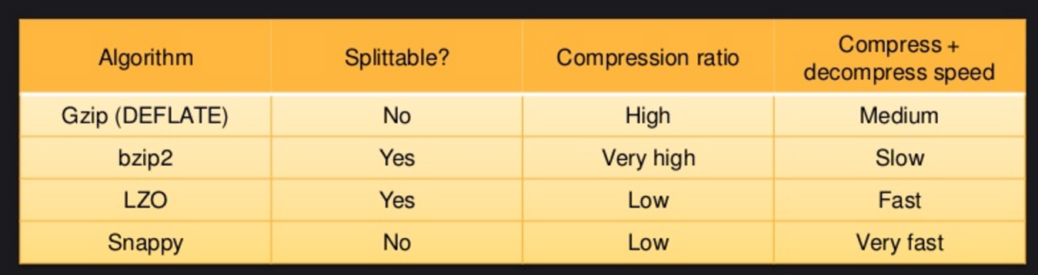

Compression
Some are fast BUT offer less space reduction
Some are space efficient BUT Slower
Some are splittable and some are not
Notes:
This table shows some of the compression formats and their attributes.

Slide 23
Storage Best Practices
Cost
Lifecycle Policies for Cost-savings
Tagging for Cost Allocation
Security
Kerberos
Encryption
EMRFS Authorization for datasets in S3
Bucket Policies, Versioning, ACLs, Tagging, Auditing
Notes:
Further storage best practices include:
Use bucket lifecycle management to delete old files or archive cold data to Glacier
Use tagging for cost allocation and Access control
Protect your data on S3 –use encryption, user and bucket policies and ACLs to control access
Use bucket versioning to minimize accidental or intentional data loss; use MFA to restrict deletes
Log S3 access by enabling CloudTrail and/or S3 Server Access Logging for auditing purposes

Slide 24




Storage Tiers
Durable
99.999999999%
“Hot” Data
Active and/or Temporary Data
≥ 0 Days
Cost
Lifecycle
Available
S3: 99.99%
S3-IA: 99.9%
S3
Performant
Low Latency
High Throughput
“Warm” Data
Infrequently Accessed Data
≥ 30 Days
S3-IA
Scalable
Elastic capacity
No preset limits
“Cold” Data
Archive and Compliance Data
≥ 90 Days
Glacier
Notes:
This graphic highlights the different tiers of S3 storage and how you can use them to minimize your storage costs.

Slide 25
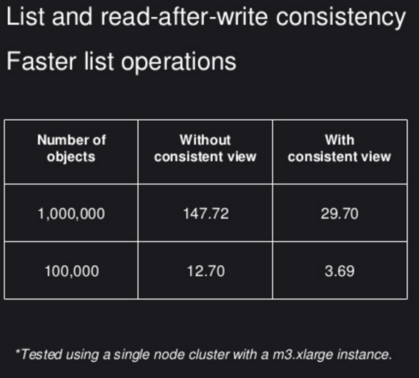
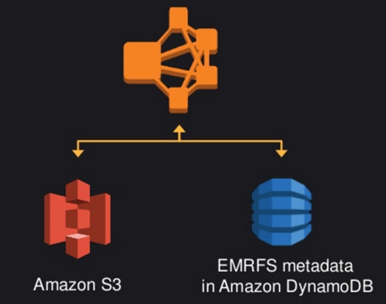
S3 Performance: Consistent View

Slide 26
Performance: Framework Performance
Embarrassingly parallel?
Can it be optimized with a DAG?
A
Count these words
B
Count = 1
These = 1
Words = 1
C
D
Count = 1
These = 1
Words = 1
E
Notes:
How to choose the tool? Can also mention (Hbase) NoSQL | graph databases | Streaming use cases about choosing framework.
One point to hightlihgt is - Embarrasingly parallel problems might not give a huge advantage by using a DAG based framework like spark. For example, if you do a word count on MapReduce and compare it with spark performance you might not see the value in there.
Pro Tip:
- So, for a good benchmark choose a problem that can use DAG optimization.
Tasks that need sharing data in-between them will work faster as it avoids having to write the temp/intermediary data to disk.
if you have already invested a lot of time in to your map reduce applications and they are performing embarrassingly parallel tasks, just work on minimizing disk spills by tuning Hadoop configuration such as sort buffer size, combiners etc.

Slide 27
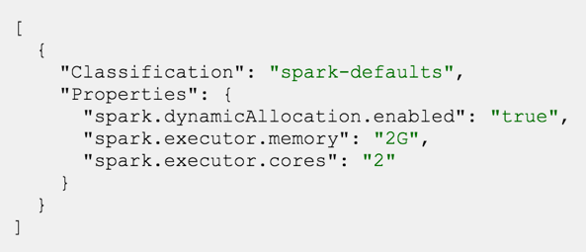
Spark: Tune it
Enable Dynamic Allocation of executors
Executor Memory
Executor Cores
YARN containers
Driver Memory
Deployment mode on YARN (Cluster | Client?)
Notes:
Automatically enabled in EMR 4.4 onwards - http://docs.aws.amazon.com/ElasticMapReduce/latest/ReleaseGuide/emr-spark-configure.html#spark-dynamic-allocation

Slide 28

Reliability
Failure Management
Disaster Recovery
Change Management
Store your metadata outside the cluster
Multi-AZ RDS cluster will give you HA
Keep data and Applications on S3
Maintain source of truth for data on S3 (An immutable data set)
Automate with:
Bootstrap actions
Config options
Cloudformation

Slide 29
Reliability: Hive metastore on RDS MySQL
[
{
"Classification": "hive-site",
"Properties": {
"javax.jdo.option.ConnectionURL": "jdbc:<db_uri>/hive?createDatabaseIfNotExist=true",
"javax.jdo.option.ConnectionUserName": "admin",
"javax.jdo.option.ConnectionPassword": ”password"
},
"configurations" : []
}
]
Config file lives on s3://<bucketname>/hive-meta-config.json

Slide 30
Security
Data Protection:
Encryption
At-rest
S3
Cluster nodes
In-transit
S3 to Cluster
Node to Node
Privilege Management
Kerberos Authentication
IAM roles
EMRFS Authorization
Secure Integration with AWS services
Hue, HiveServer2 or 3rd Party tools support for role based access
Infrastructure Protection
VPC
Private Subnets
S3 endpoints
NAT
Security Groups
Audit with logs on S3

Slide 31
Cost Efficiency
Using cost-effective resources
S3 instead of HDFS for larger datasets?
Taking advantage of Spot and Reserved instances?
Optimize over time
Monitor and watch out for new instance types, features that may reduce cost.
Matching Supply and Demand
Is the cluster big enough?
Can we make it transient?
Monitor the usage with Ganglia and Amazon CloudWatch alarms
Autoscaling
Notes:
Decoupled benefits
We discussed already about the spot instances, reserved and transient.
During well-architected design, you should think about using cost effective resources with the ability to optimize over time.
Match demand to supply with instance groups, transient clusters. You may start with monitoring the cluster utilization with Ganglia/Cloudwatch.

